Slide 1





IEEE 2nd INTERNATIONAL CONFERENCE ON COMPUTING, APPLICATIONS AND SYSTEMS (COMPAS 2025)
HOSTED BY: CENTRAL LABORATORY, ISLAMIC UNIVERSITY, KUSHTIA, BANGLADESH
23-24 OCTOBER, 2025
Paper ID:
Paper Title :
725
Ensemble Deep Learning for Brain Tumor Classification Using MRI:
A Comparative Study of CNN Architectures
Abdullah Al Mahmud Joy, Md Faizer Islam, Md. Mamun Hossain
Department of Computer Science and Engineering
Bangladesh University of Business and Technology
Dhaka, Bangladesh

Slide 2
OUTLINE OF PRESENTATION
Introduction
Literature Review
Methodology
Proposed Work
Result and Discussion
Conclusion
Reference
HOSTED BY: CENTRAL LABORATORY, ISLAMIC UNIVERSITY, KUSHTIA, BANGLADESH

Slide 3
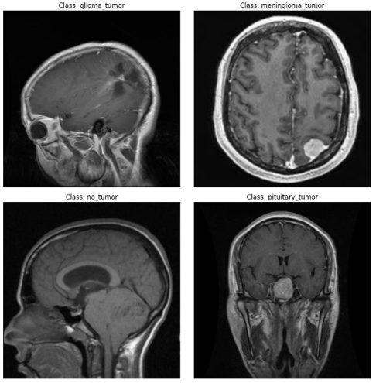
INTRODUCTION
Brain tumors are among the most deadly cancers and are difficult to diagnose accurately.
MRI is the preferred, non-invasive imaging technique for tumor detection.
Manual diagnosis by radiologists is time-consuming and prone to human error.
Deep learning (CNNs) can automatically extract features and classify tumors effectively.
Goal: Develop an automated, accurate, and interpretable CNN-based system for brain tumor classification.
HOSTED BY: CENTRAL LABORATORY, ISLAMIC UNIVERSITY, KUSHTIA, BANGLADESH

Slide 4
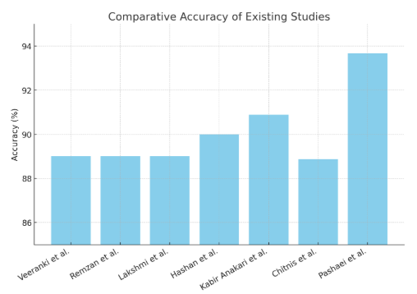
RELATED WORK
LeaSE (Chitnis et al.) → 88.87%
VGG16 (Veeranki et al.) → 89% accuracy
InceptionV3 (Lakshmi et al.) → 89%
CNN (Remzan et al.) → 89%
CNN (Hashan et al.) → 90%
CNN + Genetic Algorithm (Kabir et al.) → 90.9%
CNN + KELM (Pashaei et al.) → 93.68%
HOSTED BY: CENTRAL LABORATORY, ISLAMIC UNIVERSITY, KUSHTIA, BANGLADESH

Slide 5
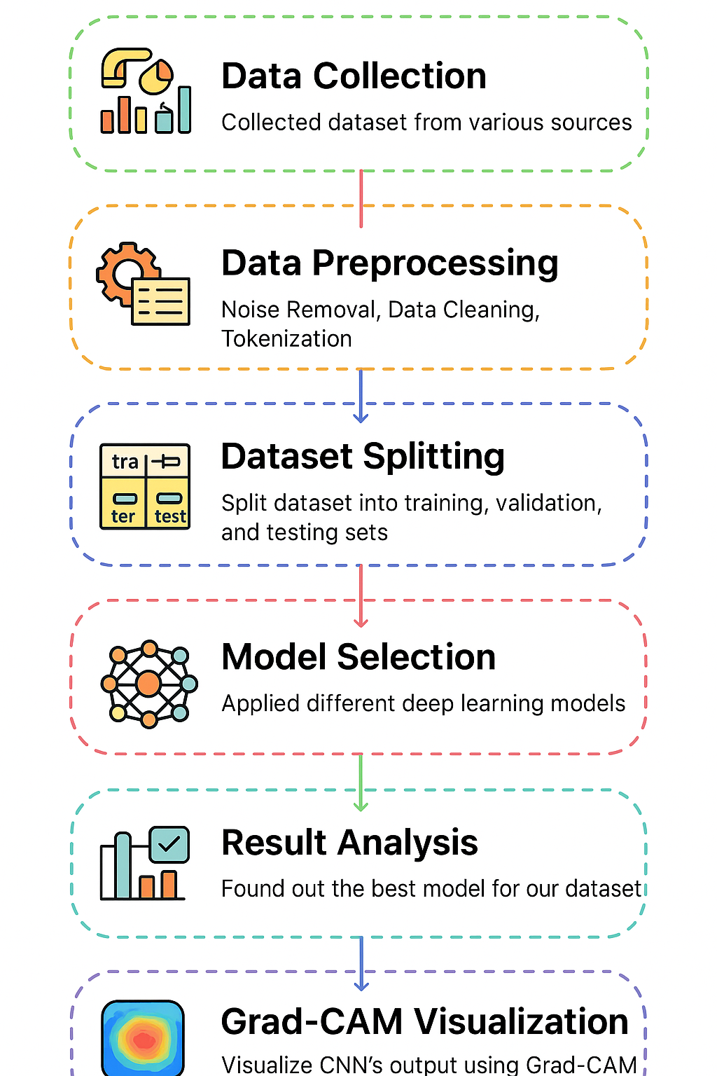
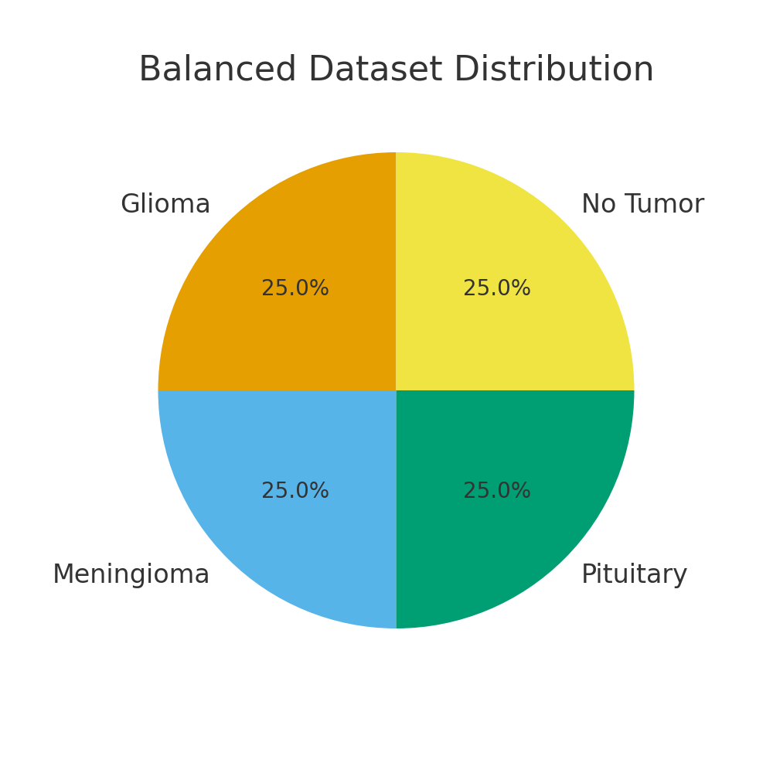
METHODOLOGY
Dataset & Setup:
10,000 MRI images (4 classes, balanced).
Split: 80% train / 10% validation / 10% test.
Preprocessing: resizing, normalization, augmentation.
Models:
Custom CNN: baseline.
MobileNetV2: lightweight, efficient.
VGG16: deep hierarchical features.
EfficientNetB0: optimized compound scaling.
Ensemble: soft voting of all four models.
HOSTED BY: CENTRAL LABORATORY, ISLAMIC UNIVERSITY, KUSHTIA, BANGLADESH

Slide 6
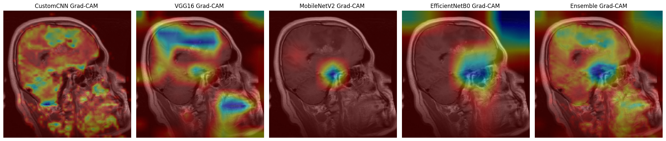
PROPOSED WORK
Developed a heterogeneous ensemble combining Custom CNN, MobileNetV2, VGG16, and EfficientNetB0 using soft voting.
Achieved 98.93% accuracy, outperforming all individual models.
Integrated Grad-CAM visualizations for explainable AI, improving clinical interpretability.
Innovation: First to combine lightweight and deep CNNs for efficient, high-accuracy MRI classification.
Relevance: Offers a scalable, interpretable, and clinically applicable framework for automated brain tumor diagnosis.
HOSTED BY: CENTRAL LABORATORY, ISLAMIC UNIVERSITY, KUSHTIA, BANGLADESH

Slide 7
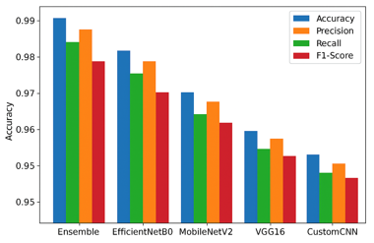
RESULTS & DISCUSSION
Ensemble → 98.93% accuracy
EfficientNetB0 → 97.62% accuracy
MobileNetV2 → 97.38% accuracy
VGG16 → 96.99% accuracy
Custom CNN → 96.79% accuracy
It also improved precision, recall, and F1-score, reducing class confusion between similar tumor types.
Implication: The ensemble approach provides a more reliable and clinically applicable solution for automated brain tumor classification.
HOSTED BY: CENTRAL LABORATORY, ISLAMIC UNIVERSITY, KUSHTIA, BANGLADESH

Slide 8
CONCLUSION
Key Takeaways
A heterogeneous CNN ensemble was developed, outperforming individual models in brain tumor classification.
Grad-CAM visualizations improved model interpretability, supporting clinical trust in AI-driven diagnosis.
The study highlights the potential of ensemble deep learning for reliable medical image analysis.
Future Directions
Validate the model on multi-center and external datasets with cross-validation for stronger generalization.
Investigate hybrid CNN–Transformer and self-supervised learning approaches to reduce data dependency.
Deploy and evaluate the model in real hospital workflows to assess its clinical practicality and scalability.
HOSTED BY: CENTRAL LABORATORY, ISLAMIC UNIVERSITY, KUSHTIA, BANGLADESH

Slide 9
REFERENCE
P. S. L. Veeranki et al., “Detection and classification of brain tumors using a convolutional neural network,” Proc. 7th Int. Conf. Trends Electr. Informatics (ICOEI), IEEE, 2023.
M. Sandler et al., “MobileNetV2: Inverted residuals and linear bottlenecks,” Proc. IEEE Conf. Comput. Vis. Pattern Recogn., 2018.
A. Pashaei et al., “Brain tumor classification via convolutional neural network and extreme learning machines,” Proc. 8th Int. Conf. Comput. Knowl. Eng., IEEE, 2018.
M. Tan and Q. V. Le, “EfficientNet: Rethinking model scaling for convolutional neural networks,” Proc. Int. Conf. Machine Learning, 2019.
S. Azizi et al., “Big self-supervised models advance medical image classification,” Proc. IEEE/CVF Int. Conf. Comput. Vision, 2021.
HOSTED BY: CENTRAL LABORATORY, ISLAMIC UNIVERSITY, KUSHTIA, BANGLADESH

Slide 10
Thank You!
HOSTED BY: CENTRAL LABORATORY, ISLAMIC UNIVERSITY, KUSHTIA, BANGLADESH

